Slide 1
CptS 327
Access Control
Notes:
Template-WSU Hrz 201.ppt

Slide 2
Today’s Topics
Access Control
  AppArmor
  HEAC
Access Control Exploits
  Meltdown & Specter
Notes:
Template-WSU Hrz 201.ppt

Slide 3
AppArmor
Linux kernel module that enables improved security
  Provides DAC, MAC, RBAC
  Flexible preprocessor to SELinux
Access privileges are defined in a ‘profile’
Profiles can be defined for subjects and objects
Modes
  Complain: produces logs of accessed objects; testing
  Enforce: block access to objects; production
Profiles and rules can be listed in /etc/apparmor.d/
Manual: https://wiki.ubuntu.com/AppArmor
Notes:
Template-WSU Hrz 201.ppt

Slide 4
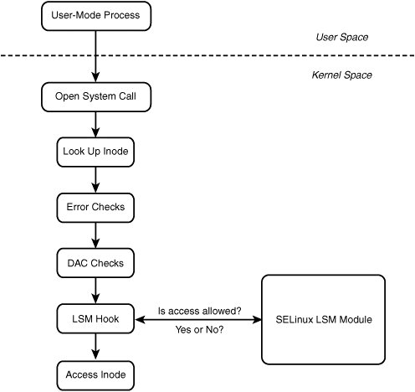
AppArmor
Notes:
Template-WSU Hrz 201.ppt

Slide 5
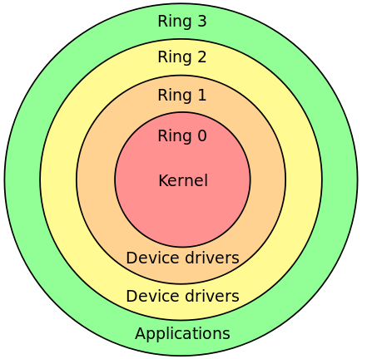
Hardware Enforced Access Control
Hardware enforced privilege levels aka ‘rings’
  Ring 3: user space
    Web browsers, office apps, etc
  Ring 0: kernel space
    Privileged instructions, memory mgmt., I/O, etc
  CPU checks if the instruction matches privilege level
  Crossing rings: use system calls and hardware interrupts
    X86 Architecture’s Privilege Rings
Notes:
Template-WSU Hrz 201.ppt

Slide 6
Hardware Enforced Access Control
Strengths
  Most secure form of access control
  Efficient at protecting a small set of functions
  Programming in assembly
Drawbacks
  CPU-intensive → slower
  Programming in assembly
Notes:
Template-WSU Hrz 201.ppt

Slide 7
In Order CPU Execution
Executes instructions in the received order
  Inst1
  Inst2
  Inst3
    MicroInst3.1
    MicroInst3.2
  Inst4
Instructions can access privileged kernel objects
Becoming obsolete as the processing is slower
Notes:
Template-WSU Hrz 201.ppt

Slide 8
Out of Order CPU Execution
Executes instructions speculatively
Speculative execution using ‘branch prediction’
  Inst1
  Inst2
  Inst4
Instructions can access privileged kernel objects
Branch prediction utilizes ‘CPU caches’
Used by most modern CPUs due to faster processing times
  Inst3
    MicroInst3.1
    MicroInst3.2
Notes:
Template-WSU Hrz 201.ppt

Slide 9
Meltdown & Specter
Access control exploits
Exploits ‘out-of-order’ execution of modern CPUs to bypass access control
Modus Operandi – Side Channel Attack
  Use cache timing to obtain exe traces
  Use exe traces to determine which objects are vulnerable
    No vulnerable objects found?
      Flush, reload, gather, and observe
    Vulnerable objects found?
      Insert code to compromise the vulnerable object’s memory
        Obtain secrets stored in compromised object’s memory
Notes:
Template-WSU Hrz 201.ppt

Slide 10
Meltdown & Specter
Differences between Meltdown and Specter
  Meltdown exploits isolation between user apps and kernel objs
    Used to compromise a device’s secrets
  Specter exploits isolation between multiple user apps
    Used to compromise a user’s secrets on different apps
    Harder to perform than Meltdown
    Harder to defend against (mitigate) than Meltdown
Notes:
Template-WSU Hrz 201.ppt

Slide 11
Meltdown & Specter
What allows these vulnerabilities?
  CPU manufacturers not wiping caches
Which systems are affected?
  Most devices
  And by extension, anything you do on the devices
How to fix?
  Manufacturers can modify CPU chips to wipe caches
    Several manufacturers applied firmware patches
  OS-level security fixes (some Unix distros)
    Implement KPTI (Kernel-Page Table Isolation)
      Separate page tables for user(s) and kernel
    Implement KASLR (Kernel-Address Space Layout Randomization)
      Make memory addresses unpredictable
Notes:
Template-WSU Hrz 201.ppt

Slide 12
More Info
More info, including practical demos and proof-of-concept code bases can be found at
  https://meltdownattack.com/
Hands on tutorial exercises can be found at (not 100% free)
  https://seedsecuritylabs.org/Labs_16.04/System/Meltdown_Attack/
Notes:
Template-WSU Hrz 201.ppt

Slide 13
Next lecture
Types of Malware
Software vulnerabilities
Notes:
Template-WSU Hrz 201.ppt

Slide 14
Any questions?
Notes:
Template-WSU Hrz 201.ppt

